Slide 1



Predicting Free Parking Spots using Data Analytics and Machine Learning + +
Andrei Ionita
Supervisors: André Pomp (IMA), Jó Agila Bitsch Link
Aachen / Master Initial Talk, December 2016

Slide 2

Motivation
Problem: Finding a parking spot takes a long time
pollutes the environment
causes unnecessary traffic
Ideal: Information about nearby parking occupancy rates
Real-time
Before departure!
Starting points
Recurring patterns in parking occupancy
Detect influencing factors in parking landscape

Slide 3
Rules for DS Slides
Use only plain, un-animated slide transitions
Do not use special animation effects
Things should pop up „hard“
Things should not fly around, glitter, sparkle, beep, blink, etc.
Don‘t overload your slides with text
Use graphs and figures
Don‘t leave slides half empty – balance the content
Try to get a consistent look – re-use colors, shapes, etc.

Slide 4
Version History
V1: ????-??-?? Tobias Heer
V2: 2009-04-03 Tobias Heer
V3: 2009-10-20 Stefan Goetz
V4: 2010-11-18 Stefan Goetz
Changed DS to ComSys logo and URLs
V5: 2011-06-14 Raimondas Sasnauskas
Changed the ComSys logo (logos/comsys/web/comsys-with-name-web.pdf)
Changed the headings font (Helvetica Neue) and it’s color (RGB: 0-66-144)
V6: 2012-01-27 Florian Schmidt
Added title page versions with English “RWTH Aachen University” logo
V7: 2012-05-15 Georg Kunz
Replaced Helvetica Neue with Arial for compatibility with Windows
V8: 2015-04-28
The Most Awesomest RWTH Aachen University Corporate Identiy: Bow Before It!
V9: 2015-09-30 Jó Bitsch
Revert to Arial (instead of Unicode), more consistent logo use

Slide 5

Shapes
Shape repository for presentations

Slide 6
Shapes
Shape repository for presentations

Slide 7
Colors and Shapes – Bevel
Bevel
Flat
Bevel
Flat
GSM
GSM
Bla
Bla
WiFi
WiFi
Blubb
Blubb
WiMax
WiMax
Bli
Bli
Blo
Blo
Gump
Gump

Slide 8
Arrow Styles

Slide 9
Your very important remark goes here
Your very important message goes here

Slide 10






Visio Devices

Slide 11
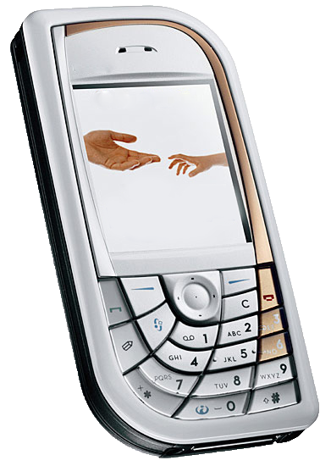

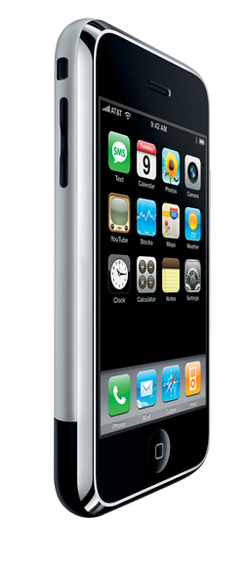
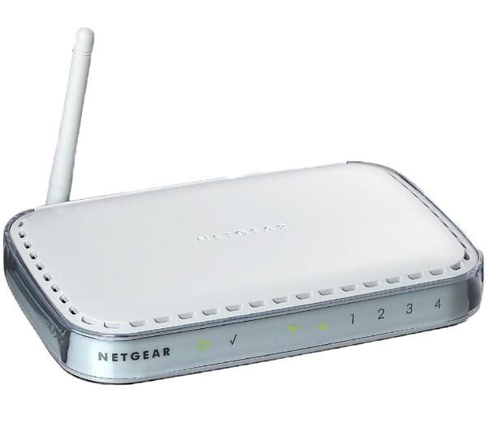
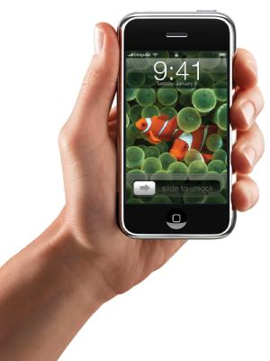


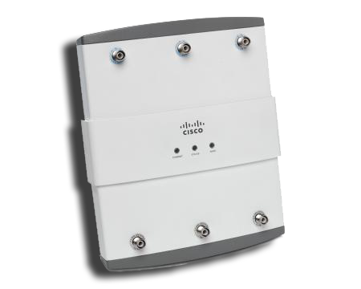

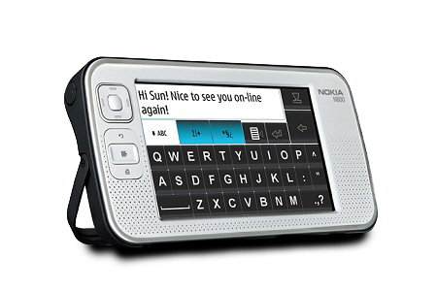
Devices

Slide 12




Misc

Slide 13





Logos

Slide 14
Integrity Protection - Delayed Key Disclosure
s
v
1.
m
M(h_{n-1}, m)
Key
2.
h_{n-1}
Temporal separation between 1. and 2.
Time synchronization / epochs (TESLA)
Interaction (Zero Common Knowledge, WIMP, Guy Fawkes)
Notes:
Animation + text mit klammer

Slide 15
Interactive Hash Chain Signatures in ALPHA
General hash-chain based signature model:
?
?
r₁
?
s
r₂
r₃
v
ALHPA model:
r₁
s
X
r₂
r₃
v
1. Path reservation
2. Verifier grants permission
3. Sender sends message m
X
X
X
Notes:
How can this work in multi-hop networks?
Ths is not useful.

